Slide 1
SSW345 Model-Based Software Engineering
Course Introduction
Prof. Ye Yang

Slide 2
General Information
Instructor: Dr. Ye Yang
  Email: ye.yang@stevens.edu
  Office: Babbio 537
  Office hour: anytime (by appointment)
Grader: Herbert J Zieger III
  Email: hzieger@stevens.edu
Lectures:
  Tuesdays: 12:30 – 1:20 PM
  Thursdays: 12:30 – 2:20 PM
  Location: Babbio 310

Slide 3
Textbooks and References
Performance Solutions: A Practical Guide to Creating Responsive, Scalable Software, by Connie Smith and Lloyd Williams, First Edition. ISBN-13: 978-0201722291. ISBN-10: 0201722291.
Software Abstractions: Logic, Language, and Analysis, by Daniel Jackson. MIT Press, 2006. ISBN-13: 978-0262017152. ISBN-10: 0262017156.
Additional course materials will be made available through the course’s CANVAS site.

Slide 4
The Big Picture
What factors impact the quality of a software system?
  Functionality
    E.g. correctness, completeness
  Performance
    E.g. response time, scalability, cost
Model and measure software systems to simulate, analyze and find quality problems ahead of time
It is much easier to identify and correct quality problems early in the design phase than it is when all code is written!

Slide 5
Course Content at a Glance
Introduction (Week 1)
  Introduction to Course
  Introduction to UML
Software Performance Analysis (Week 2-6)
  Software Execution Model
  Software Architecture and Styles
  System Execution Models
  Software Contention/Workload
  Software measurement/instrumentation
Math Foundation for Reasoning (Week 7-8)
  Sets, Relations, and Functions
  Propositional Logic and Predicate Logic
Notes:
Introduction to Course
Introduction to UML
No class. Monday class schedule
Review for midterm
MidTerm Exam
No class. Stevens Spring break
Introduction to Alloy
Modeling in Alloy - Static
More Alloy Examples

Slide 6
Course Content at a Glance (cont’d)
Modeling/Reasoning Sequential Software Systems (Week 10-11)
  Finite State Machine
  State Machine Variations
  Reasoning with FSM
Modeling/Reasoning High Level Design (Week 12-13)
  Introduction to Alloy
  Modeling in Alloy - Static
  More Alloy Examples
Industry: DevOps, Technical Interview (Week 14-15)

Slide 7
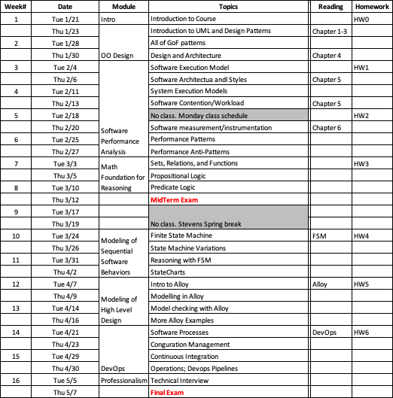
Schedule

Slide 8
Grading Scheme
Homework (50%)
  Seven small projects
  Apply what you learn to practice
    Skills for modeling and analysis
    Skills for programming
    In-class presentation.
  You may work in a group of 2, or individually
In class activities (10%)
Pop quizzes (5%)
Midterm (15%)
Final Exam (20%)

Slide 9
Prerequisites
SSW 315 Object Oriented Software Engineering or equivalent
MA 134 Discrete Math or equivalent

Slide 10
Knowledge
Knowledge of object-oriented programing (e.g., Java) assumed
Knowledge of the following can further help
  logic in computer science
  finite automata
  testing, debugging, and verification
  concurrent programming
if you took any of those: nice
if not: don't worry, we introduce everything we use here

Slide 11
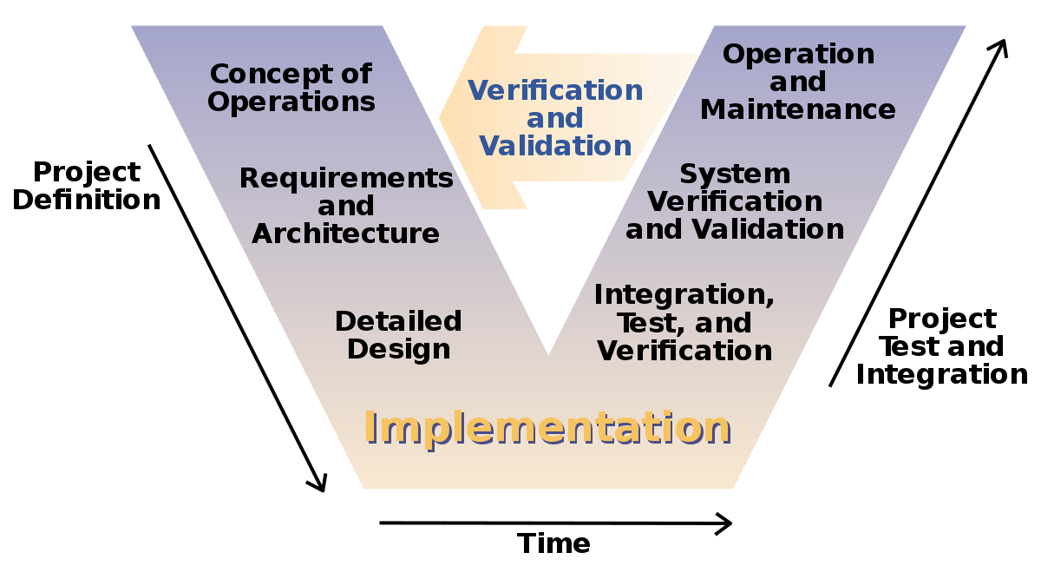
How do we develop software?
The V-Model

Slide 12
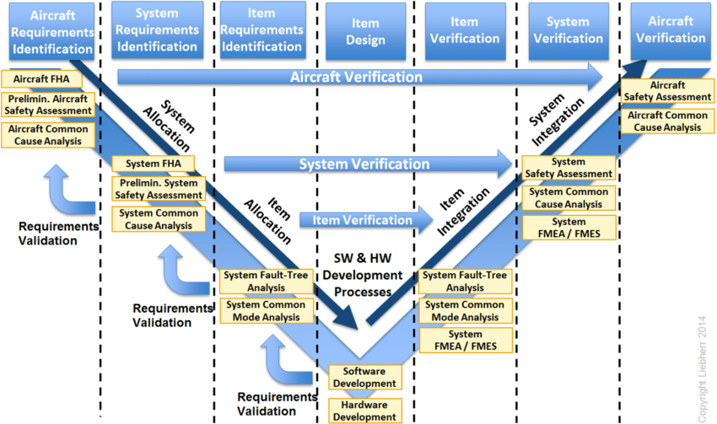
V-Model for the avionics domain
Avionics V-Model extract from the ARP4754A

Slide 13
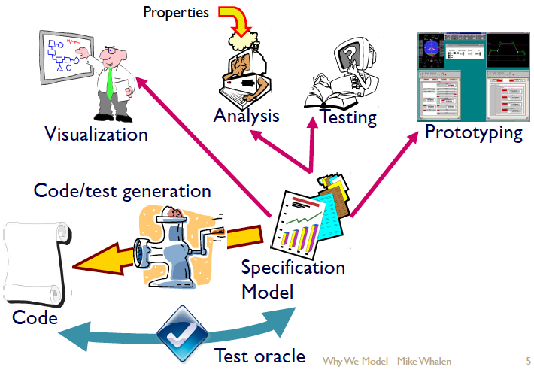
What is Model-Based Development?

Slide 14
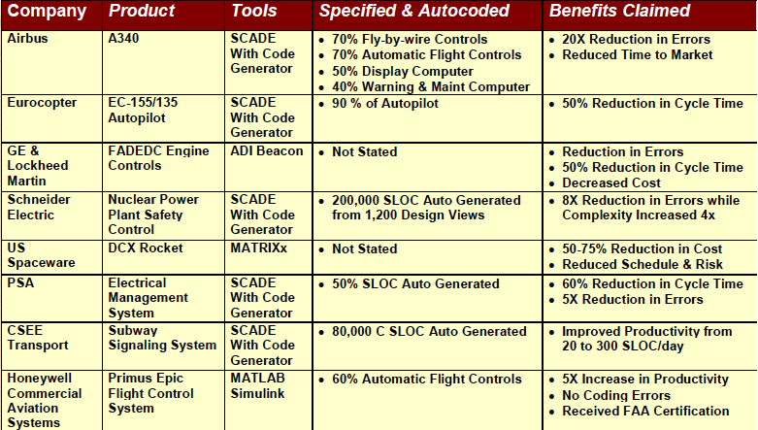
Model Based Development Examples
Source: Steve Miller in “Proving the Shalls” © 2006 Rockwell Collins, Inc. All rights reserved.

Slide 15
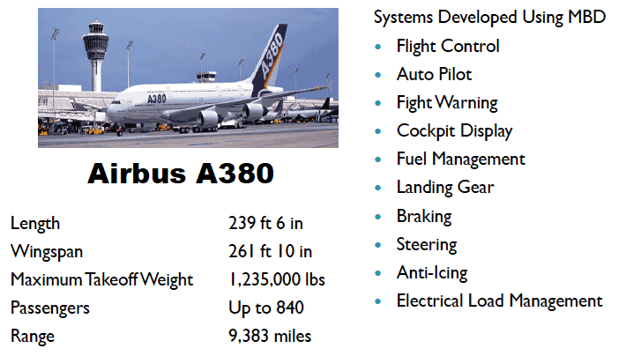
Does Model-Based Software Engineering Scale?

Slide 16
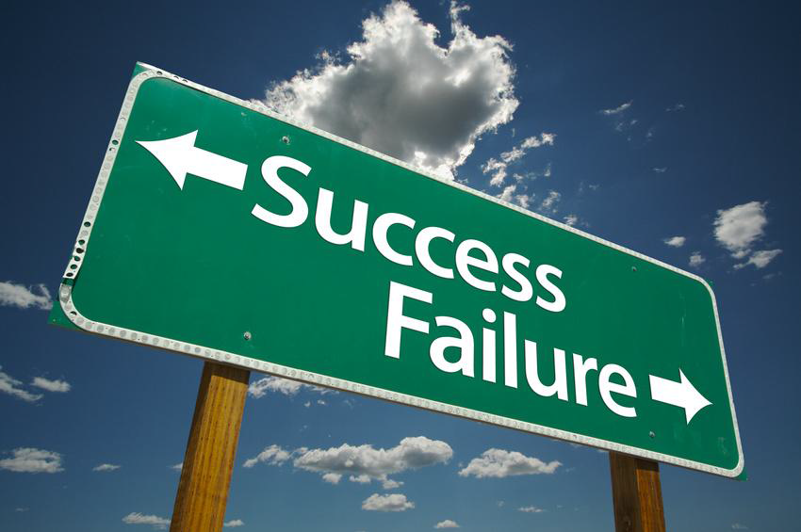
…But it is not all roses
Many MBD projects fail to meet their original goals of cost, productivity
  These tend not to get as much publicity!
Clear eyed understanding of why you model and what you expect is necessary
Notes:
A Personal Anecdote
 Part of two large projects using Model-Based
Development
◦ Same company, similar quality developers
◦ One great success
 Significant cost reductions
 Improvement in quality
 Excellent customer satisfaction
◦ One great failure
 Large cost overruns
 Models considered less
useful than code
 Group abandoned MBD

Slide 17
What are your models for?
Possible to use MBSE for many different purposes:
  Requirements
  Design
  Simulation
  Visualization
  Testing
    Test Generation
    Test Oracle
  Formal Verification
  Code Generation
  Complete implementation
  Code skeleton
  Prototyping
  Communication with Customer
We are going to learn, up front, what you expect to do with models in order to successfully adopt MBD.
Major opportunity for improvements in V&V

Slide 18



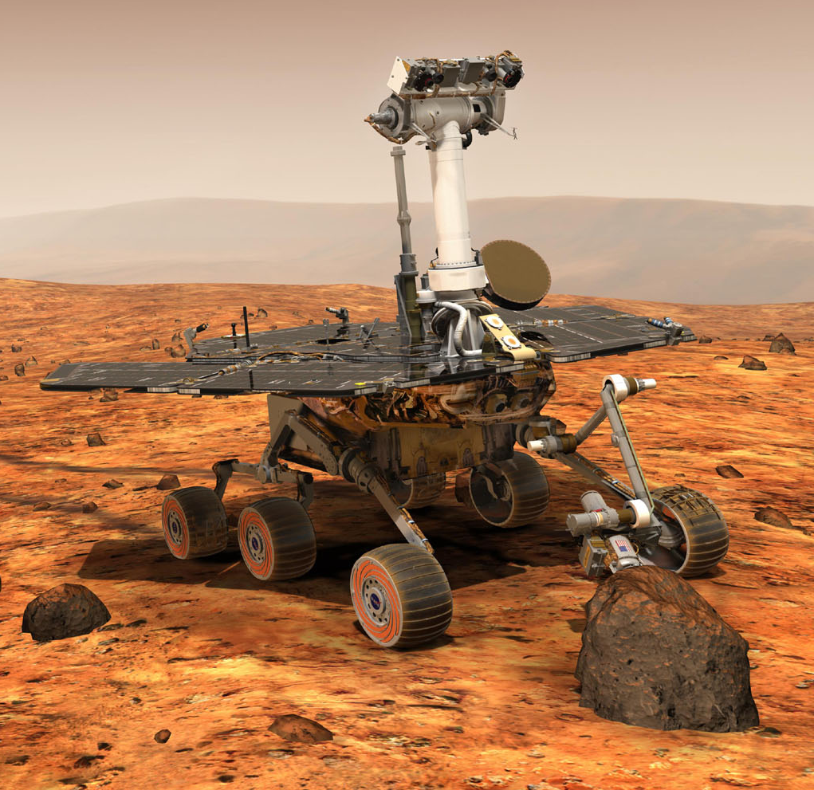

Why Model-Based Software Engineering?
If life were like this, we’d not need model-based software engineering

Slide 19
Software Defects cause BIG Failures
Tiny faults in technical systems can have catastrophic consequences
In particular, this goes for software systems
  Ariane 5
  Mars Climate Orbiter
  London Ambulance Dispatch System
  …
Notes:
On June 4, 1996 an unmanned Ariane 5 rocket launched by the European Space Agency exploded just forty seconds after its lift-off from Kourou, French Guiana. The rocket was on its first voyage, after a decade of development costing $7 billion. The destroyed rocket and its cargo were valued at $500 million. A board of inquiry investigated the causes of the explosion and in two weeks issued a report. It turned out that the cause of the failure was a software error in the inertial reference system. Specifically a 64 bit floating point number relating to the horizontal velocity of the rocket with respect to the platform was converted to a 16 bit signed integer. The number was larger than 32,767, the largest integer storeable in a 16 bit signed integer, and thus the conversion failed.
Mars Climate Orbiter began the planned orbital insertion maneuver on September 23, 1999 at 09:00:46 UTC. Mars Climate Orbiter went out of radio contact when the spacecraft passed behind Mars at 09:04:52 UTC, 49 seconds earlier than expected, and communication was never reestablished. The primary cause of this discrepancy was that one piece of ground software supplied by Lockheed Martin produced results in a United States customary unit, contrary to its Software Interface Specification (SIS), while a second system, supplied by NASA, expected those results to be in SI units, in accordance with the SIS. Specifically, software that calculated the total impulse produced by thruster firings calculated results in pound-seconds. The trajectory calculation software then used these results - expected to be in newton-seconds - to update the predicted position of the spacecraft.^{[16]}
he second attempt embarked
upon in 1991 also faced serious challenges which eventually led to
its collapse on 4 November 1992, barely 9 days after its launch. The system was never tested
as an entity meaning LAS had no prior knowledge of how the
system would appear and how problems would be dealt with.

Slide 20
Software Defects cause OMNIPRESENT Failures
Ubiquitous Computing results in Ubiquitous Failures
Software is almost everywhere:
  Mobiles
  Smart devices
  Smart cards
  Cars
  …
Software/specification quality is a growing commercial and legal issue

Slide 21
Examples of Performance Failures
News media Web sites after 911
  4 seconds is the acceptance/tolerable rate for loading a web page
  It took on average 13 seconds for home pages of news Web sites to load on Tuesday morning
CNN.com, New York Time
  The sites cut photos, graphics, text and ads from the first page, leaving just one story on static Web sites

Slide 22
Achieving Reliability in Engineering
Some well-known strategies from civil engineering
  Precise calculations/estimations of forces, stress, etc.
  Hardware redundancy (\make it a bit stronger than necessary")
  Robust design (single fault not catastrophic)
  Clear separation of subsystems
  Design follows patterns that are proven to work

Slide 23
Why This Does Not (Quite) Work For Software?
Software systems compute non-continuous functions
  Single bit-flip may change behavior completely
Redundancy as replication doesn't help against bugs
  Redundant SW development only viable in extreme cases
No clear separation of subsystems
  Seemingly correct sub-systems cause global failures
Software designs have very high logical complexity
Most SW engineers untrained to address correctness and performance issues
Cost efficiency favored over reliability

Slide 24
How to Ensure Software Correctness/Performance?
A central strategy: testing
  (others: SW processes, reviews, libraries, . . . )
Testing against internal SW errors (\bugs")
  design (hopefully) representative test configurations
  check intentional system behavior on those
Testing against external faults
  inject faults (memory, communication) by simulation or radiation
  trace fault propagation

Slide 25
Limitations of Testing
Testing shows presence of errors, not their absence
  (exhaustive testing viable only for trivial systems)
Representativeness of test cases/injected faults subjective
  How to test for the unexpected? Rare cases?
Testing is labor intensive, hence expensive

Slide 26
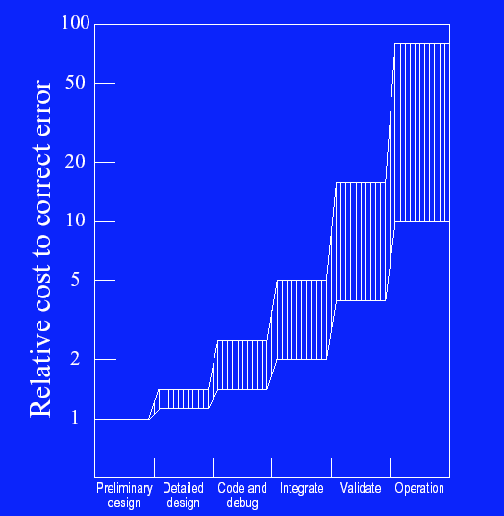
Relative Cost to Correct Error

Slide 27
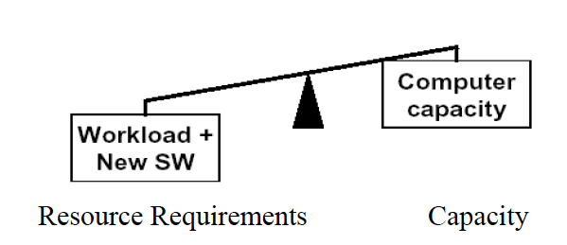
Software Performance Analysis
UML-based modeling and analysis
Detect problems early in developments and use qualitative models/methods to support cost-effective analysis

Slide 28
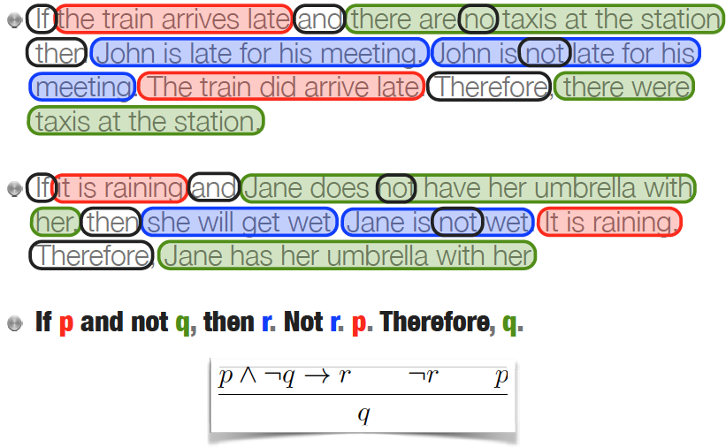
Logical Form of Arguments
Notes:
The aim of logic is to develop language to model the situations that we encounter as SOFTWARE ENGINEER. In such a way that we can reason about them formally. Reasoning about situations means constructing arguments about that. we want to do this formally, so that arguments are valid and ca nbe defended rigorously, or executed on a machine through simulation.

Slide 29
Modeling of Sequential Software Behaviors
b
a, b
Finite State Machines
Example in Game Programming
a
q₀
b
q₁
a
q₂
Monster in sight
Gather Treasure
Flee
No monster
Monster dead
Cornered
Fight

Slide 30
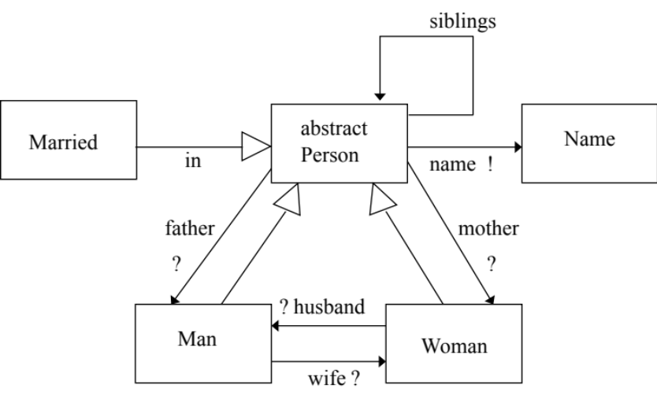
Modeling/Analysis of High Level Design
Alloy- based modeling and analysis
  Another object oriented modeling language
  has formal syntax and semantics
  has a visual language similar to UML class diagrams
  has a constraint analyzer which can be used to automatically analyze properties of Alloy models

Slide 31
HOW THINGS CHANGED
(Like 10 minutes ago)

Slide 32
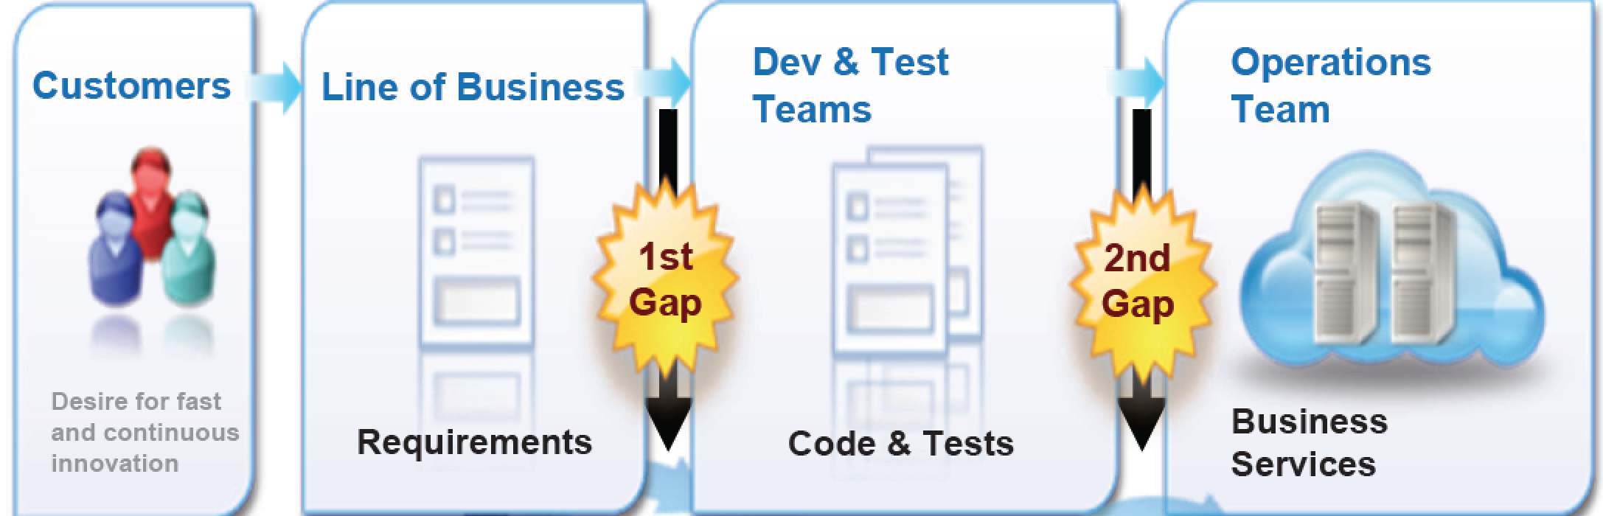

Everyone lives in ”their own world”
Slow response to market changes
Slow response to miscommunications (at all steps)
Slow response to problems
Notes:
Problems

Slide 33
Agile/Extreme
Processes
EVEN WITH AGILE:
Hard to deploy quickly, easily, correctly
Different Skill sets between ops/dev
Slow response to problems (replication)
Notes:
Problems

Slide 34
With DevOps:
Move things “easily” to deployment--- NOT EASY!!
No ”skills” difference
Respond quickly to differences.
Notes:
We will also learn some modern software tools to support DevOps.

